Slide 1

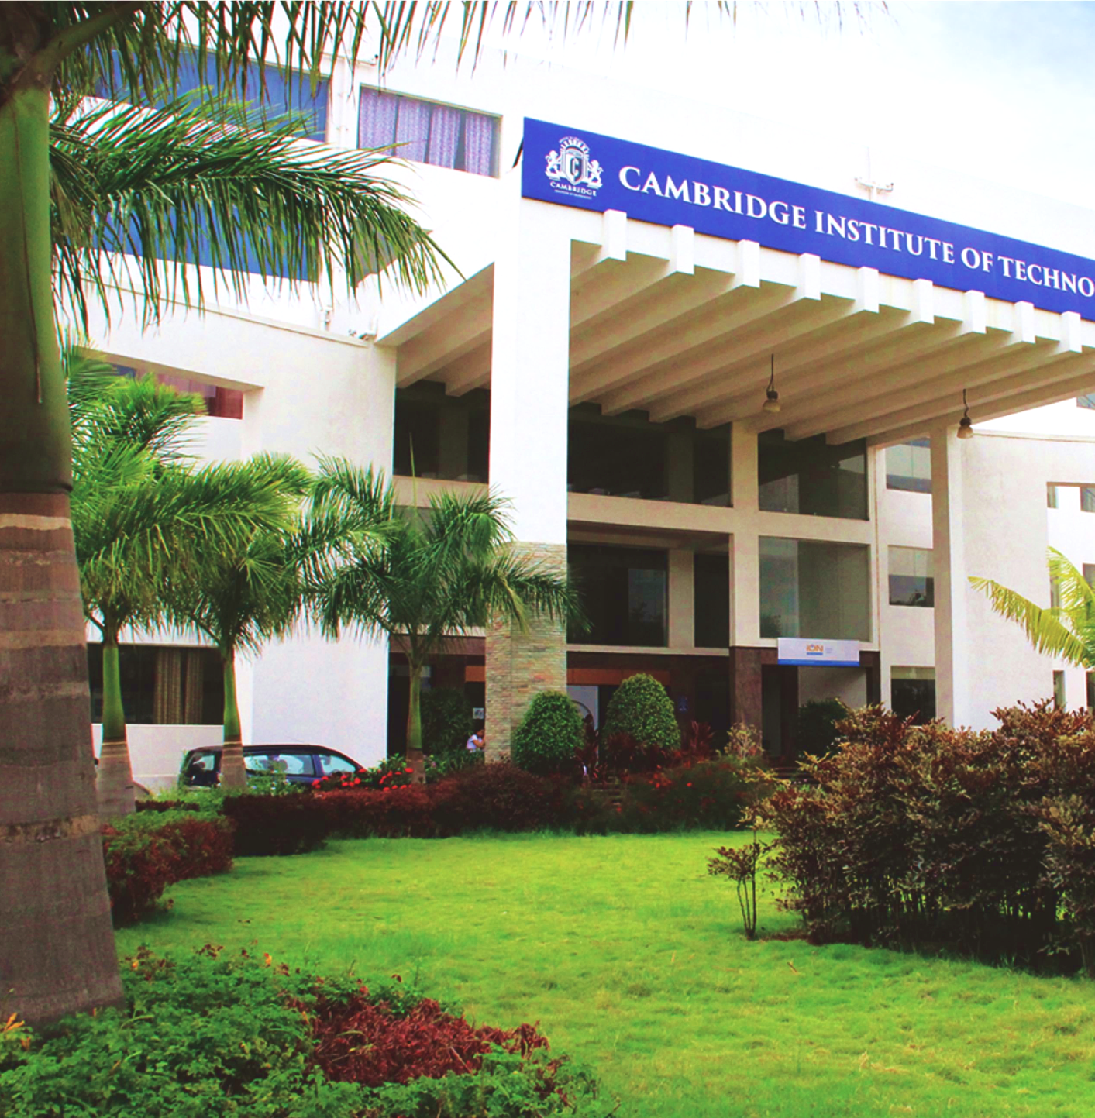
www.cambridge.edu.in
Subject Code: BAI685
Project Name: Machine Learning Driven Real-time Contamination Dectection in Urban Water Pipelines
Under the Guidance of : Prof. Raja. A
Presented By :
Roshan R K Vashista(1CD22AI047)
Poola Mahalakshmi(1CD22AI044)
Divya. J(1CD22AI014)
Department of Artificial Intelligence and Machine Learning

Slide 2
Understanding the Problem Statement: Ensuring Safe Urban Water
Bengaluru's Urban Water Challenge: Rapid urban growth and limited freshwater sources have strained Bengaluru's infrastructure, increasing reliance on vulnerable distribution systems.
Aging & Complex Pipeline Networks: Water from sources like the Cauvery River is delivered via aging and often undocumented pipelines, managed by BWSSB, increasing risk factors.
Contamination Risks: Frequent pipe bursts, illegal tapping, and intermittent supply create negative pressure, allowing contaminants to enter the distribution network.
Department of Artificial Intelligence and Machine Learning www.Cambridge.edu.in

Slide 3
Problem Statement: Limitations of Current Monitoring
Manual Sampling & Lab Testing: Traditional water quality monitoring depends on periodic sampling and centralized laboratory analysis.
Delayed & Expensive: These methods introduce significant latency and cost, preventing timely contamination alerts.
Lack of Real-Time Insight: No continuous surveillance across the pipeline network, leading to missed localized contamination events.
Need for Intelligent, Scalable Monitoring: Modern urban systems require low-cost, real-time solutions capable of continuous anomaly detection.
Department of Artificial Intelligence and Machine Learning www.Cambridge.edu.in
Notes:
The goal is to enhance the speed and effectiveness of disaster relief efforts.

Slide 4

Methodology from Literature Review: IoT & Sensor-Based Monitoring
Shift Toward IoT Monitoring
Research by Essamlali et al. and Kumar et al. showcases IoT systems for real-time water quality tracking.
Common Hardware Platforms
Devices like Arduino, ESP32, and Raspberry Pi used with standard water quality sensors: pH, TDS, Temp
Flexible Communication Protocols
Wi-Fi for dense areas, LoRaWAN for wide-range applications (e.g., Georgantas et al.).
Cloud & Local Data Platforms
Data aggregated using platforms like Firebase, ThingSpeak, or local servers for analysis
Department of Artificial Intelligence and Machine Learning www.Cambridge.edu.in

Slide 5
Literature Review: Machine Learning & Data Handling
ML for Anomaly Detection: Papers like Banda et al. apply algorithms like Random Forests to detect faults using IoT sensor data.
Concept Drift & Adaptivity: Studies (e.g., Li et al.) emphasize handling dynamic baselines with online learning models.
Labeled Data Scarcity: Rare contamination events limit real-world training data; prompts need for data augmentation.
Visualization Standards: Prometheus and Grafana widely adopted for monitoring and visualizing time-series sensor data.
Department of Artificial Intelligence and Machine Learning www.Cambridge.edu.in

Slide 6
Our Methodology: A Phased Approach to an Intelligent System
Ultimate Goal
Build an RPi-based intelligent sensor node with onboard ML for real-time anomaly detection using water quality data.
Phase 1 Focus
Construct physical sensor node (pH, TDS, Temp) and a simulated multi-node network on RPi.
Simulation Tools
Python-based simulators, Prometheus for data scraping, Grafana for real-time visualization.
Justification
Allows validation of data pipeline and visualization workflow before tackling real-world ML deployment.
Department of Artificial Intelligence and Machine Learning www.Cambridge.edu.in

Slide 7
Technology Justification (Phase 1 Demonstration)
Raspberry Pi: Cost-effective and powerful enough to run simulators, Prometheus, Grafana, and future ML models.
Python: Supports rapid development of simulators and exporters via prometheus_client.
Prometheus: Efficient time-series data collection; uses a pull-based model ideal for structured metrics.
Grafana: Versatile and open-source dashboard tool that integrates well with Prometheus.
Simulation Model: Allows real-time testing of anomaly logic and network behavior before deploying multiple hardware units.
Department of Artificial Intelligence and Machine Learning www.Cambridge.edu.in

Slide 8
Detailed Design & Architecture: Phase 1 Prototype
Raspberry Pi as Central Host: Runs all services including Prometheus, Grafana, and multiple Python node simulators.
Node Simulators: Python scripts acting as virtual sensor nodes, each exposing /metrics endpoint via unique ports.
Prometheus Integration: Scrapes each node’s metrics periodically and stores time-series data.
Grafana Visualization: Dashboards read from Prometheus to show node status and water quality trends.
Contamination Triggering: Manual file triggers induce contamination status to simulate events in real-time.

Slide 9
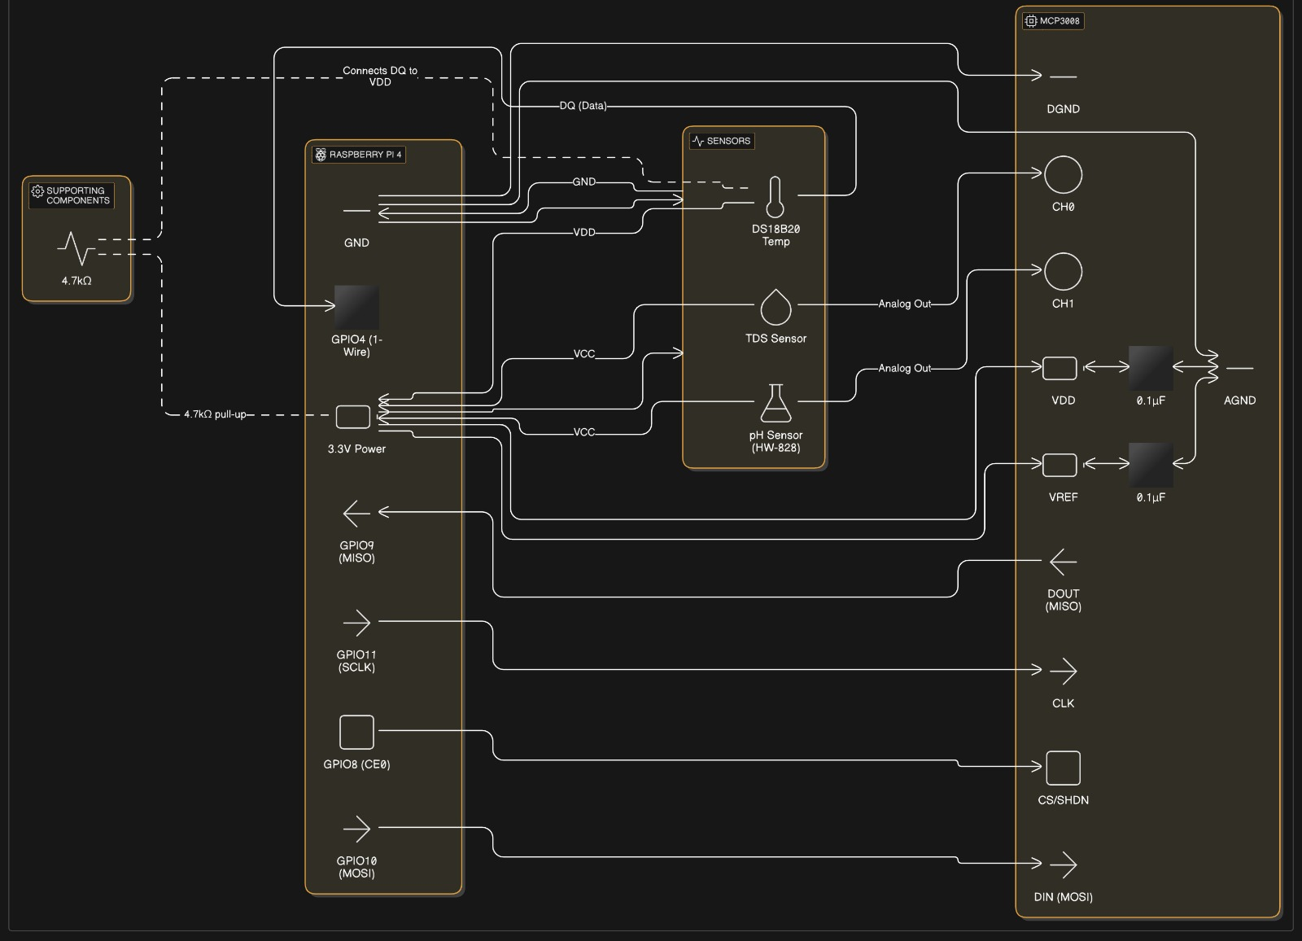

Slide 10
Phase 1 Prototype: Hardware & Software Components
Raspberry Pi 4: Acts as central controller; runs simulation, Prometheus, Grafana, and data collection.
Sensor Interfaces: MCP3008 ADC connected to pH, TDS, and DS18B20 temperature sensors via GPIO.
Software Stack: Python 3 for simulators, prometheus_client for metrics export, Prometheus + Grafana stack.
Data Handling Configs: Uses prometheus.yml and optional nodes_config.json for simulator setup.
Control & Trigger Scripts: Shell and Python scripts manage simulator operations and simulate contamination events.

Slide 11
Initial Implementation: Grafana Dashboard - Normal Operation
Simulated Node Status
All virtual sensor nodes report within expected water quality ranges; indicators show green.
Real-Time pH & TDS Charts
Time-series graphs show typical minor fluctuations in sensor data across nodes.
Highlight: Physical Node
One simulator represents the real RPi node collecting actual sensor data in the background.
Visual Feedback Mechanism
Grafana panels update in near real-time based on Prometheus-scraped metrics.

Slide 12
Phase 1 Achievements & Learnings
End-to-End System Validation: Confirmed data flow from sensor nodes to Prometheus and Grafana dashboards.
Successful Multi-Node Simulation: Created multiple Python-based node simulators with rule-based anomaly detection.
Initiated Real Data Collection: Real sensor prototype collecting background data to support future ML modeling.
Software Stack Feasibility: All components—Prometheus, Grafana, exporters—run effectively on a single RPi.
Scalability Insight: Identified need for automated dashboard generation using grafanalib or Grafana API.

Slide 13
Conclusion & Path to Phase 2: Towards True ML Detection
Successful Phase 1 Execution: Demonstrated IoT monitoring concept and validated system architecture on RPi.
Data Foundation for ML: Initiated collection of real-world data for future ML training and evaluation.
Next Step: Data Augmentation: Train cGANs to synthesize diverse, labeled contamination events.
ML Integration: Deploy trained ML model on RPi for live anomaly detection via onboard sensors.
Enhanced Visualization & Alerts: Expand Grafana capabilities with dynamic dashboards and alert integrations.

Slide 14
THANK YOU
Department of Artificial Intelligence and Machine Learning www.Cambridge.edu.in

